Slide 1
Model Optimization and Intro to Model Deployment
Week 5 - Day 1

Slide 2
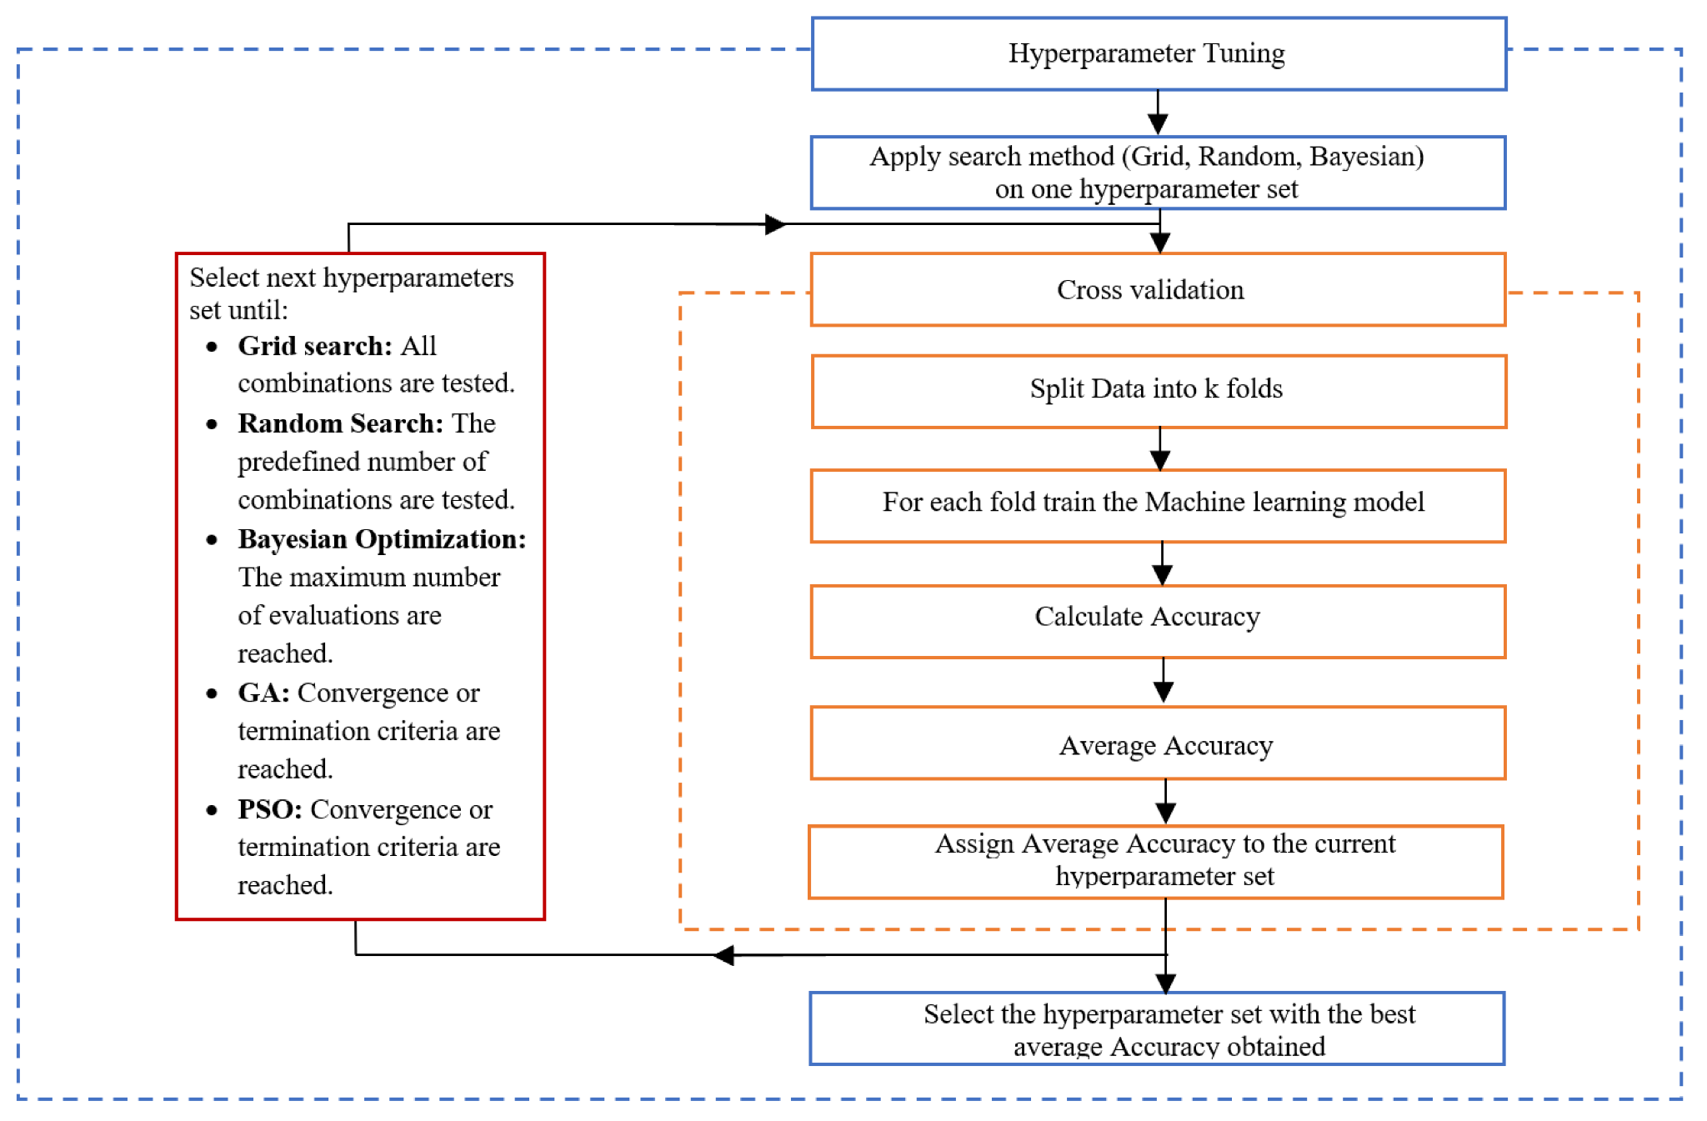

Slide 3
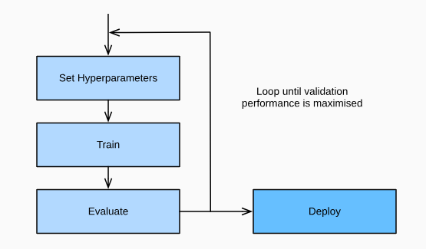
Introduction to Hyperparameter Tuning
Hyperparameter tuning involves selecting the best set of hyperparameters for a learning algorithm to optimize its performance on a given task.​
Importance:
Proper tuning can lead to improved model accuracy, generalization, and efficiency.
Example:
Choosing the optimal 'C' and 'gamma' values for a Support Vector
Machine (SVM) with an RBF kernel to achieve the best classification
performance.

Slide 4
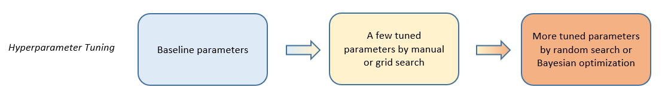
Overview of Tuning Methods
Grid Search:
An exhaustive search over a specified hyperparameter grid.
Random Search:
Random sampling of hyperparameter values from defined distributions.
Bayesian Optimization:
A probabilistic model-based approach that uses past evaluation results to select the most promising hyperparameters to evaluate next.

Slide 5
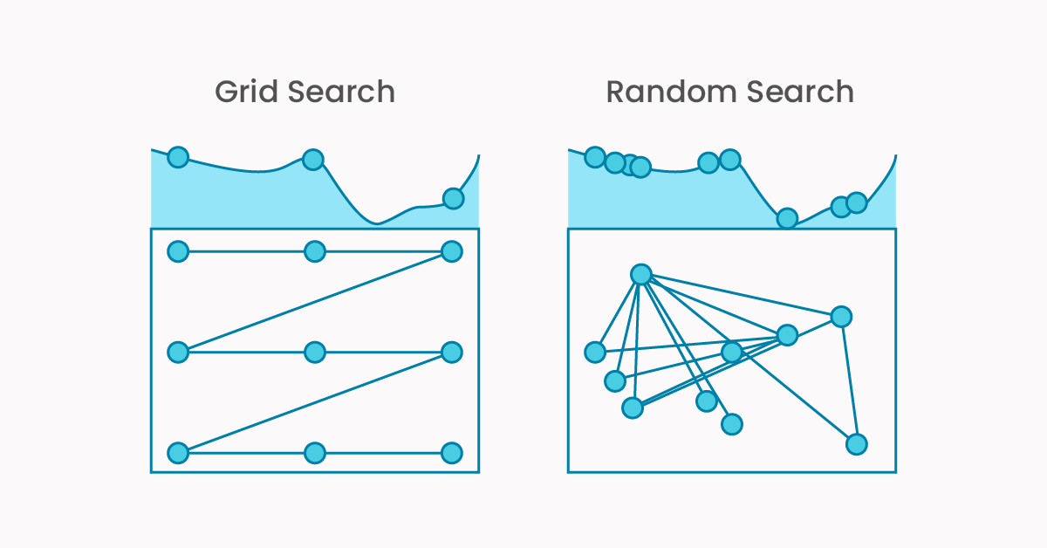
Grid Search
Systematically evaluates all possible combinations of a predefined set of hyperparameters.
Advantages
Exhaustive Search: Ensures all specified combinations are tested.​
Simplicity: Easy to implement and understand.
Disadvantages
Computationally Intensive: Evaluates every combination, which can be expensive with large hyperparameter spaces.​
Curse of Dimensionality: The search space grows exponentially with the number of hyperparameters, making it impractical for high-dimensional spaces.
Example: Tuning the 'C' and 'gamma' parameters for an SVM classifier by evaluating all combinations from predefined sets.

Slide 6
Random Search
Samples hyperparameters randomly from specified distributions.
Advantages
Efficiency: Can outperform grid search, especially when only a few hyperparameters significantly affect performance.​
Scalability: Handles large and continuous hyperparameter spaces better than grid search.
Disadvantages
No Guarantee of Optimality: May miss the best combination due to random sampling.​
Variable Performance: The quality of the results can vary between runs.
Example: Randomly selecting values for 'learning_rate' and 'batch_size' in a neural network to find effective hyperparameters.​

Slide 7
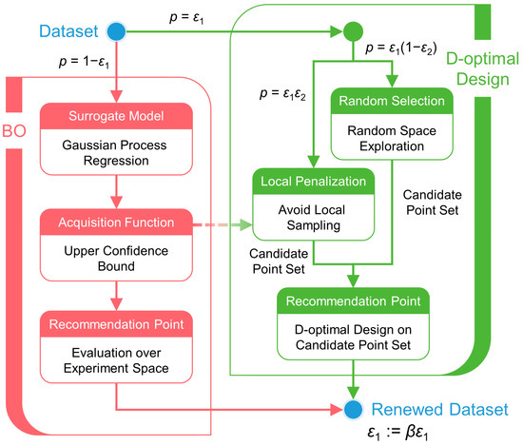
Introduction to Bayesian Optimization
A probabilistic model-based optimization technique that builds a surrogate model to predict the performance of hyperparameters and uses this model to select the most promising hyperparameters to evaluate next.
Advantages
Sample Efficiency: Requires fewer evaluations to find optimal hyperparameters compared to grid and random search.​
Balances Exploration and Exploitation: Effectively navigates the hyperparameter space by considering both untested and promising regions.​

Slide 8
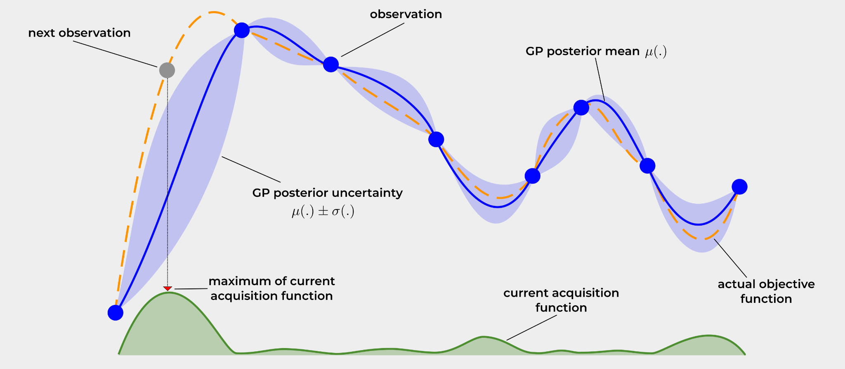
Introduction to Bayesian Optimization
How it works?
Surrogate Model: Constructs a probabilistic model (e.g., Gaussian Process) of the objective function.​
Acquisition Function: Utilizes an acquisition function to decide where to sample next, aiming to improve performance.​
Iterative Process: Iteratively updates the model and selects new hyperparameters to evaluate based on past performance.

Slide 9
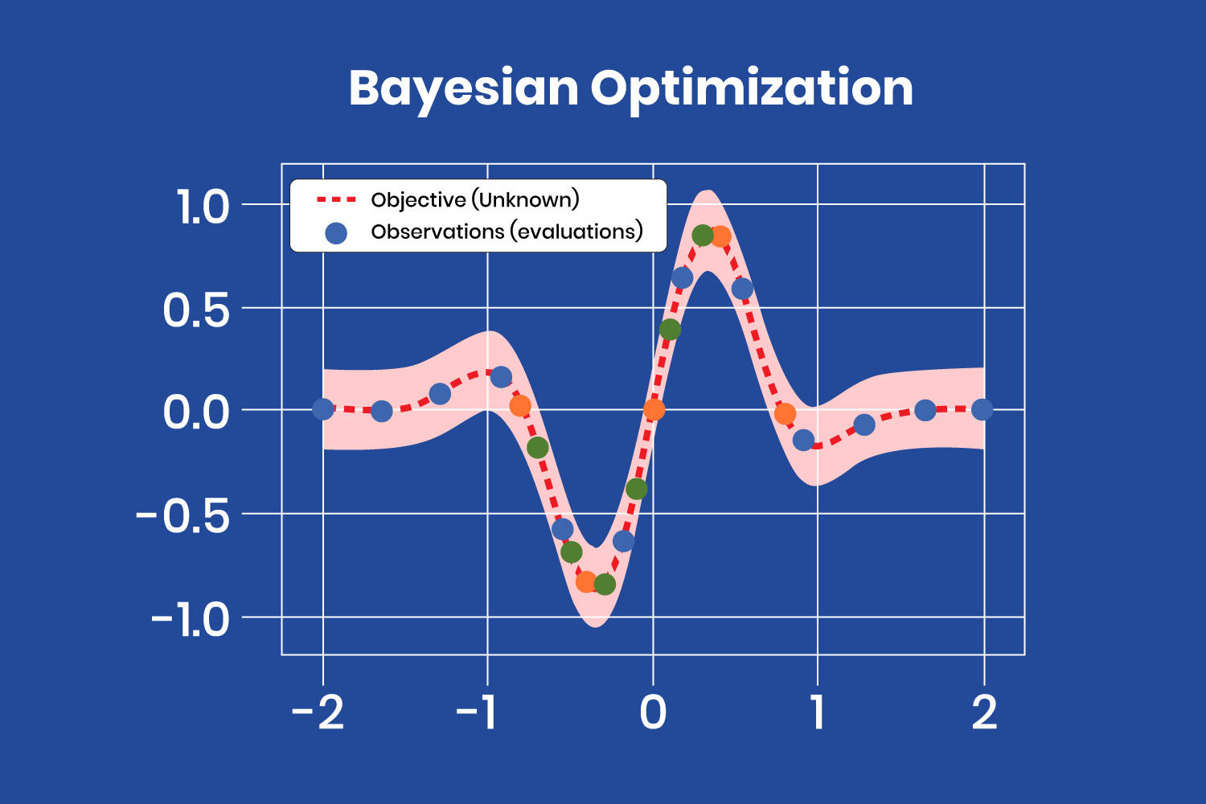

Slide 10
Comparison of Methods
Method | Pros | Cons
Grid Search | Exhaustive search, simple implementation | Computationally intensive, suffers from the curse of dimensionality
Random Search | More efficient, explores a broader range | May miss optimal combinations, results can vary
Bayesian Optimization | Sample-efficient, balances exploration and exploitation | More complex to implement, requires additional computational resources

Slide 11
Practical Considerations
Choosing a Method:
Grid Search:
Suitable for small, discrete hyperparameter spaces where exhaustive search is feasible.​
Random Search:
Effective for larger or continuous spaces, especially when only a few hyperparameters significantly impact performance.​
Bayesian Optimization:
Ideal for expensive-to-evaluate functions or when computational resources are limited, as it seeks to find optimal hyperparameters efficiently.

Slide 12
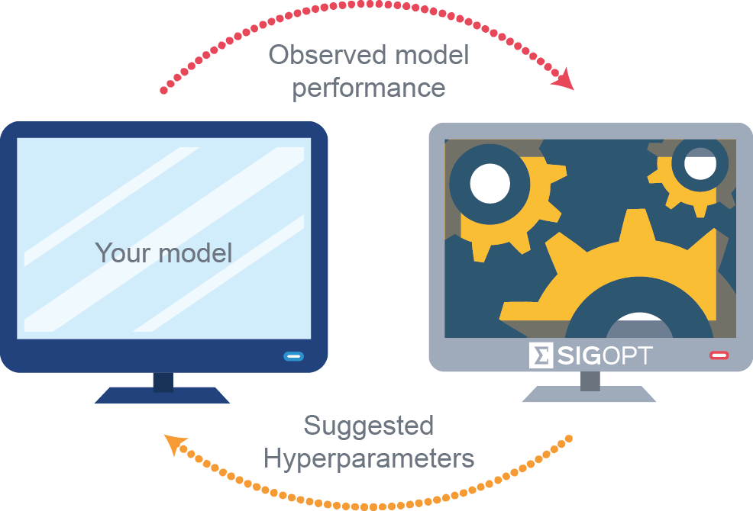
Practical Considerations
Cross-Validation:
Employ techniques like k-fold cross-validation to assess model performance during tuning, helping prevent overfitting.​
Computational Resources:
Consider the available computational power and time constraints when selecting a tuning method, as methods like grid search can be resource-intensive.

Slide 13
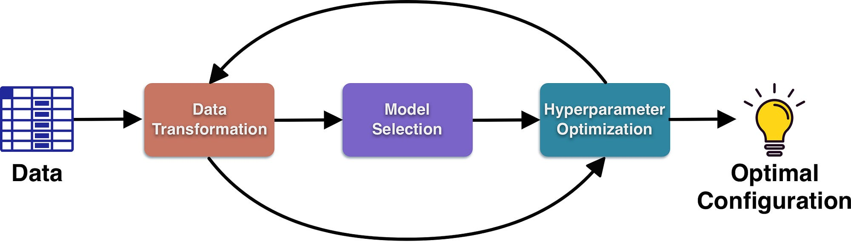
Conclusion
Effective hyperparameter tuning is crucial for building robust machine learning models that generalize well to new data.​
Selecting the appropriate tuning method depends on factors such as the size of the hyperparameter space, computational resources, and the specific characteristics of the problem at hand.

